Slide 1
Cultural evolution and Prestige bias
Thesis defense

Slide 2
Contents
Introduction - traits and transmission
Prestige, success and transmission biases
The model - influence, prestige bias
Mathematical approximations - GBD and DM
The binary model
Fixation probability and time estimations
Estimations in a changing environment

Slide 3
Introduction

Slide 4
Traits
Attributes or properties that characterize an individual
Traits are found in most living organisms, simple and complex
Traits can be genetic or cultural
Genetic trait - eye colour
Cultural trait - blessing before a meal

Slide 5
Transmission
The process when an individual acquires a trait of another
Like traits, transmission can be both genetic and cultural
Genetic transmission is vertical in most organisms
Cultural transmission can be vertical, oblique, horizontal and reverse vertical

Slide 6
Transmission bias
The bias towards inheriting/transmitting one phenotype or the other of a given trait
In evolution, there’s rarely a bias in the transmission of the phenotype
The offspring inherits the genes of the parents, and doesn’t choose them
In cultural evolution, it is very common to see biases towards certain phenotypes, based on other parameters of the role-model
Direct bias
Frequency bias
Indirect bias

Slide 7
Success bias
Copying of a phenotype depends on the success of the role model observed
The more successful the role model, the more likely its traits to be copied
Success is both direct and indirect bias
An individual may copy the indicative trait he’s observing
It may copy other traits of the role model, based on the indicative trait

Slide 8
Prestige
In the literature, prestige is rarely mentioned, even in cultural biases focused papers
When mentioned, it is as a synonym to success, or as a theoretical concept
In my research I was interested in the difference between success and prestige
The main difference:
Success is determined solely by the expression of the traits
Prestige is also affected by the environment, and how others perceive the role model
We define prestige as the bias caused by the colleagues choices of role-models

Slide 9
Research questions
Can we find a simple analytical model for the prestige bias?
Prestige has inner generation dependencies
How does the prestige bias affect the populations behaviour?
Is it aiding the advantageous traits or oppose them?
What are the effects on the time to fixation

Slide 10
Models

Slide 11
Reminder
Wright Fisher model - mathematical model meant to describe genetic drift
Generations do not overlap
Each gene in the new generation is drawn randomly from the previous generation
Moran model
Generations overlap
Every time step one individual reproduce and one dies
Our model is mainly based on a WF model, and borrows some features from the Moran model

Slide 12
The model
Consider a population of N individuals, each individual has a trait on a continuous scale:
Every generation, N naive individuals (copiers) must inherit (choose) a trait to copy
The can only choose from the individuals of the previous generation (role-models)
We assume generations do not overlap, similar to a WF model
Our model is inspired by the work of Boyd & Richerson (1988), by assuming only oblique transmission of the trait which they name Indicator trait
We didn’t include the second trait of their model, the Indirectly biased trait to lower the complexity of our model

Slide 13



The model
The model’s state at time t is described by
describes the indicator trait values at time t
is drawn from a standard normal distribution

Slide 14

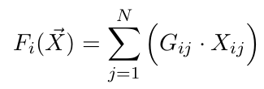
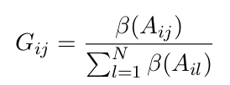
Inheritance
The process of copying a trait is shown in the following equations
The trait value of copier i after copying
The Evaluation function of copier i to quantify traits appeal
The relative score copier i assign to each role-model j

Slide 15

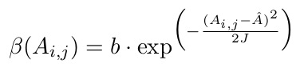
Inheritance
The trait value copier i perceives role model j has, with an error
The function of estimating the appeal of a given trait,
relative to the ideal trait
To put simply, copier i ranks all the role-models based on his perception of the traits, and randomly chooses one to copy, influenced by his innate error

Slide 16



Influence
We define influence to be a bias towards a role-model that was already chosen by the i-1 copiers
When copier i is choosing a role-model, the state of role models is can be described as
Where when copier i chosen role-model j, and 0 otherwise

Slide 17

Prestige in our model
We define prestige as a weighted combination of success and influence
The probability to choose a role model is conditional as follows:
As we can see, the probability to choose role-model j depends on the number of copiers each role-model has until that point in time

Slide 18

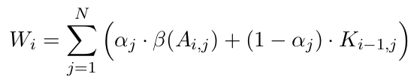
Prestige
We define the score copier i assign to to role-model as follows:
Simply put, it is a weighted average of success and influence

Slide 19
Mathematical approximations
Our process is defined as an iterative process inside the generation, which is complicated both to compute and to analyze
We found two approaches to estimate our model’s behaviour:
General Binomial Distribution (GBD)
Dirichlet Multinomial (DM)

Slide 20

General Binomial Distribution
A series of Bernoulli experiments, with possible dependency between experiments
A general binomial process was defined by Drezner and Farnum (1993) by the following formula:
which is the probability of role-model j to have k copiers after i copiers chose a role-model, when we assume no errors
This probability can be defined by the following recurrence equation:

Slide 21

General Binomial Distribution
We saw the selection of a role-model is GB distributed
Based on that, we can calculate the expected number of copiers:
Which means the expected numbers of copiers role-model j will have at the end of the selection process is equal to the population size multiplied by the initial probability to be chosen

Slide 22

General Binomial Distribution
When assuming homogeneous weight ratio,
We get
Which means the expected number of copiers is linearly proportional to the success bias of role-model j

Slide 23
Dirichlet Multinomial Distribution
Using the GBD we could estimate the expected value of copiers a single role-model will have with ease
Going further, we can equivalent our model to a more convenient distribution - the Dirichlet Multinomial (DM) distribution
Using the DM approximation, we can calculate the expected copiers of the entire population at once, contrary to a single role-model at a time with the GBD

Slide 24
Dirichlet Multinomial & Polya Urn
In a paper by Frigyik et al (2010), they proved that a Polya Urn model will converge to a DM distribution as the number of draw increases
We proved our model is interchangeable with a Polya Urn model, by assuming no error rates, as in GBD, and homogeneous trait weight as well
In our model the number of draws is the population size, which is large, hence the DM serves as a good approximation

Slide 25
Polya Urn - Rich getting richer
Polya Urn reminder - Consider an urn filled with N balls of k colors
Draw a random ball, observe its color, and return the ball to the urn
In addition, add another additional ball with the same color

Slide 26
Prestige model as Polya Urn
Our model is based on a WF model, hence constant population size and no overlap between generations
This seems contradictory to the Polya Urn model at first
However, due to the increase of value once a role-model is chosen, we proved mathematically that the models are identical after tweaking the model’s equations

Slide 27

Prestige model as DM
Following Frigyik et al and Durrett’s Martingale Convergence Theorem (1999), we can approximate our model using the DM distribution as follows
Where the state of copiers at generation i is DM distributed with only N (population size) and the initial prestige vector, depends only on the success of the role-model

Slide 28


The binary model
The DM approximation seems to be good, but it was still hard to mathematically analyze this model
We therefore limited our model to having only two phenotypes instead of the infinite continuous scale
This model is described by the following transition equation

Slide 29

The binary model
This equation describes the probability of copier i to inherit trait A
N-X is the number of role-models with the A trait in the previous generation
Having only two traits, analyzing and comparing simulation metrics is a lot easier

Slide 30
Results

Slide 31
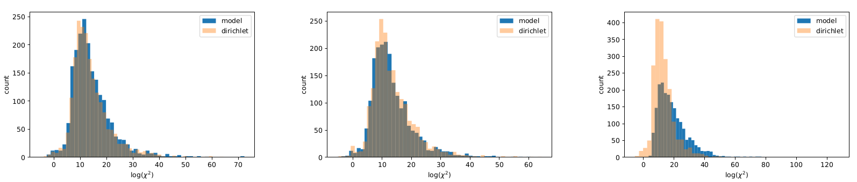
DM - validation
We ran multiple simulations to support our claims
We simulated a single generation step with N=2000, with varying error rate
We wanted to see the effects of adding errors to the model, to see how much it deviates from the math

Slide 32
DM - validation
To compare the models, we compared their Chi-squared metric with different error values
We see that with a 0.01 error rate (1%), the metrics are impressively similar
When increasing the error rate to as high as 0.1, the plots are still very similar
It’s only for very large values (e=1) that the similarity stops suggesting our approximation is good, even with errors implemented

Slide 33
Binary model - simulations
We observed two main metrics - fixation probability and time to fixation by an invading ideal trait
A simulation starts with a single role-model with the ideal trait, while the rest of the population possess trait A
We wanted to see how well our approximation fits our model with varying degrees of deviation from the original assumptions

Slide 34
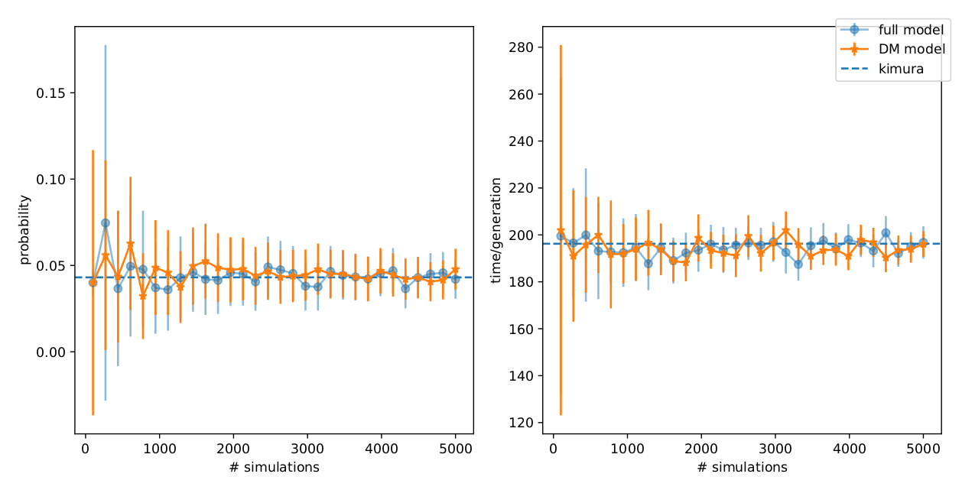
Simulations
The first thing we tested was how many simulations are needed to properly estimate our metrics
We compared the results of the DM approximation with our model with gradually increasing number of simulations
In these simulations N=1000
We found that 1000 simulations are consistent enough to be used

Slide 35
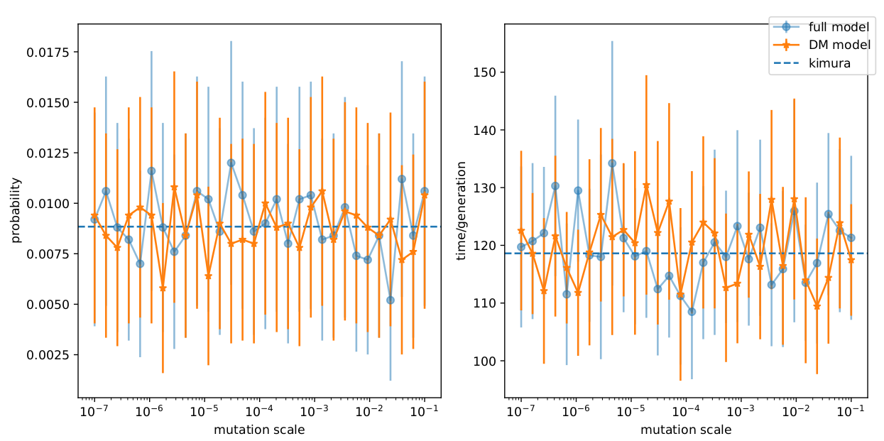
Simulations - mutation
The next step was to observe how the approximation deviates from the real model with a varying degree of deviation from the equation
We first tested the effects of mutation rate on the metrics

Slide 36
Simulations - mutation
Before the stage of choosing a role-model, we drew samples from a random distribution and used the samples to change the prestige estimations of the copiers
The x-axis represents the variation of the distribution used

Slide 37

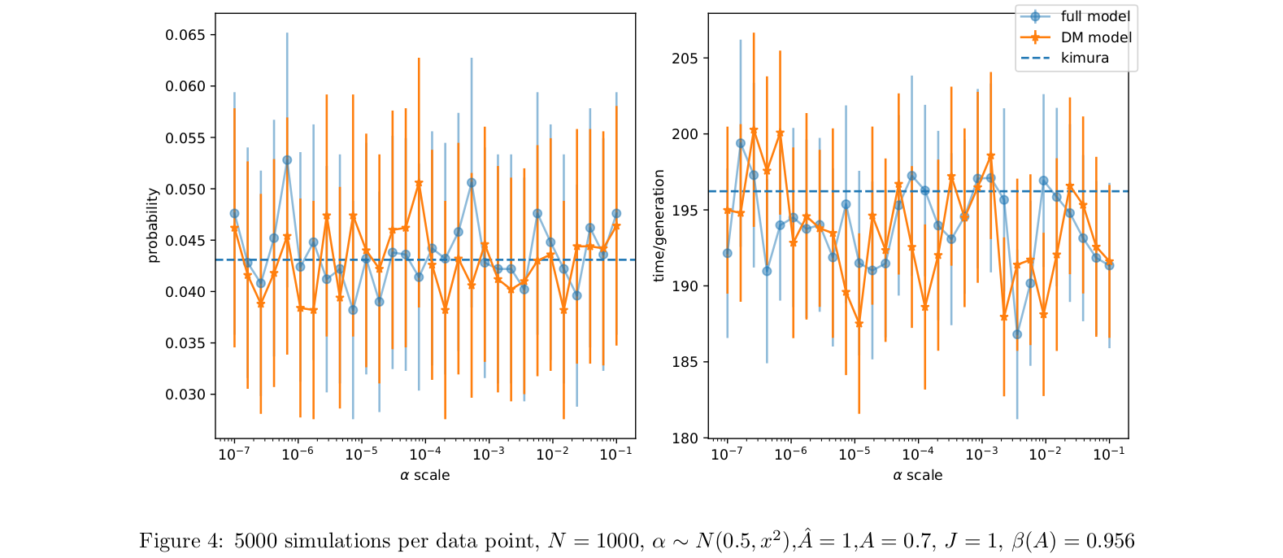
Simulations - trait weight
After discovering that the DM approximation is quite resilient to mutation, we tested the resilience to heterogeneous trait weight
We again drew from a normal distribution

Slide 38

Kimura’s equations
After observing the resilience of the DM approximation, we continued to analyze the model mathematically
We based our analyzation on Kimura’s equations, inspired by Durrett (2008)
We found out that is equivalent to the selection coefficient in a WF model
We then successfully went on calculate the expected and variance of the change in frequency between generations

Slide 39


Effective population size
In our calculations we found the effective population size for our model
Using these, we successfully came up with an equation resembling Kimura’s for the fixation probability

Slide 40

Kimura’s approximation
We also applied Kimura’s equation for time to fixation on our model, though like Kimura’s, the equation is too complex to solve mathematically
Using these equations, we compared our model to the WF model, using our alternatives parameters

Slide 41
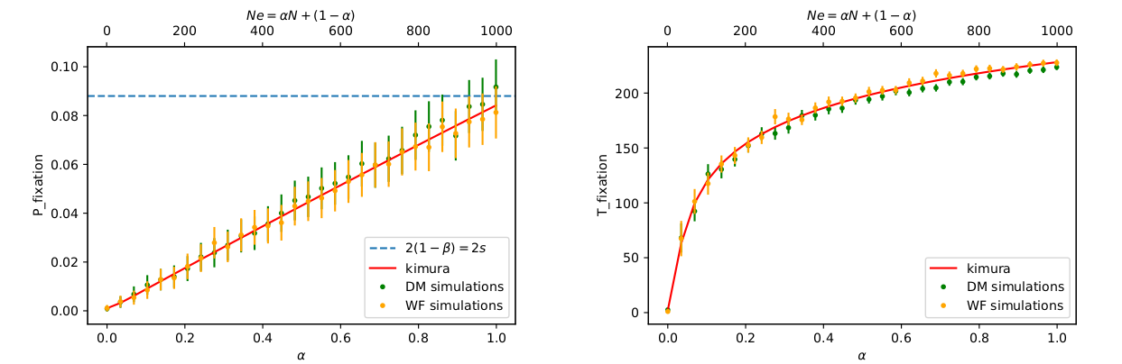
DM and WF approximations
We ran 5000 simulations for each combination of parameters, both for the DM and the WF model
These results are for variating trait weight, which directly affects effective population size

Slide 42
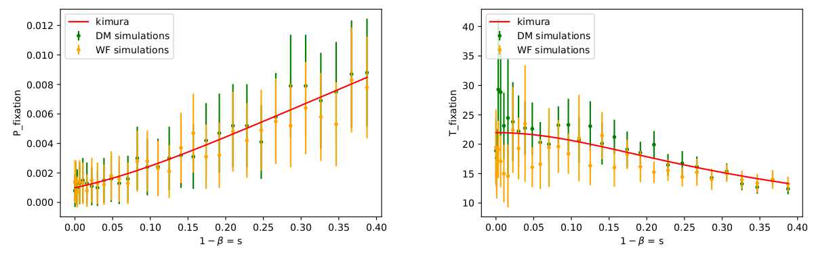
DM and WF approximations
We ran the same number of simulations, using the selection coefficient as the variable
We see that even for high values of s the approximation holds

Slide 43
Changing environment
Lastly, we wanted to see how changing the environment during the process affects the results
The changing environment is done by switching the advantageous and common traits every few generations
After k generations, the common trait becomes the advantageous one for a period of l generations
After n=k+l generations has passed, the cycle reiterates

Slide 44
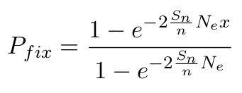

Changing environment
Basing our math on Ram et al’s (2018) proof of a similar scenario, we found a modified version of our Kimura’s approximation
The fixation probability now uses the average of the selection coefficients of a complete cycle n:

Slide 45
Changing environment - simulations
When running simulations we noticed our modified approximation works only when certain parameters are restricted
It appears that for high values of s, our approximation fails
Kimura’s equations in general are only valid for small s, but we found out this restriction is magnified in a changing environment
Another interesting fact was that the smaller n was, the better the modified equation fit the simulations

Slide 46
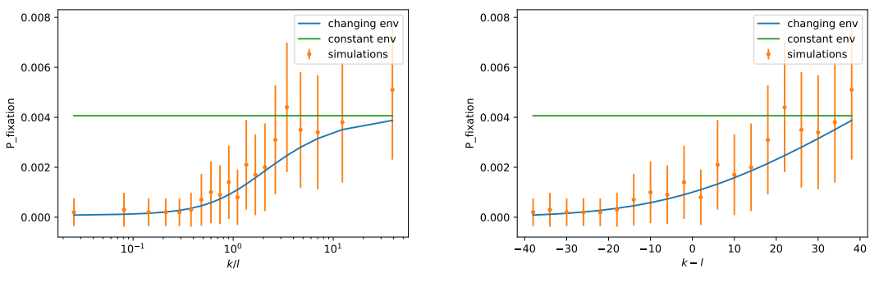
Changing environment - simulations
We ran 10,000 simulations for each data point, and kept a constant cycle size n=40
We then changed the ratio of k,l only, and we see that when k>>l the modified equation for changing environment expects results similar to the constant one

Slide 47
Summary

Slide 48
Summary
We modeled prestige naively as a nested loop stochastic process
The inner loop is caused by the dependency of a copier on his colleagues choices
We found two mathematical approximations to help us analyze our model
We analyzed our model in its binary form
We created a variation of Kimura’s equations to fit our model
We compared our model in a constant environment to a changing one

Slide 49
Discussion
When researching prestige we focused on the effects on the influence in contrast to a success biased model
From the math and the simulations, we reached an interesting conclusion
The influence doesn’t affect the number of expected copiers a role-model will have
It only affects the variance - which is manifested in an effective population size

Slide 50
Discussion
The stronger the influence, the smaller the effective population size is
This cause the population to reach fixation a lot faster
It is coincide with our literal definition of it - influence by its nature doesn’t support nor oppose the success (Rich getting richer)
It is therefore an “accelerator” of the state, hastening the fixation or extinction of a trait

Slide 51
Research questions
Can we find a simple analytical model for the prestige bias?
Yes, in its binary form
How does the prestige bias affect the populations behaviour?
The influence is a “neutral force”, that accelerate the population state
The only mathematical manifestation of the influence is in the effective population size

